Slide 1
Accounting for population structure
Structured population models in phylodynamics

Slide 2
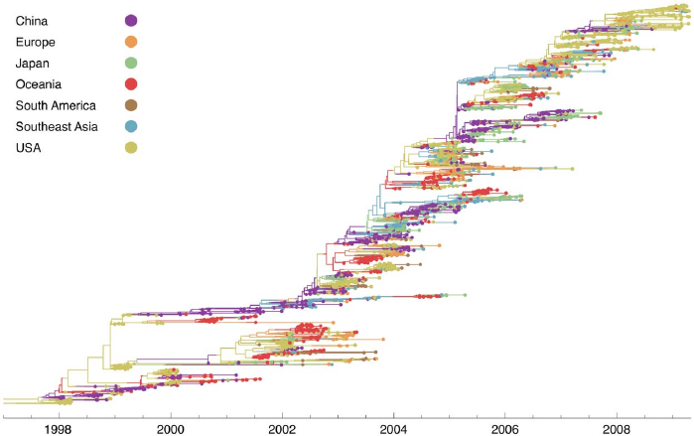
H3N2 sequences show spatial clustering
Bedford et al., 2010, PLoS Path.

Slide 3
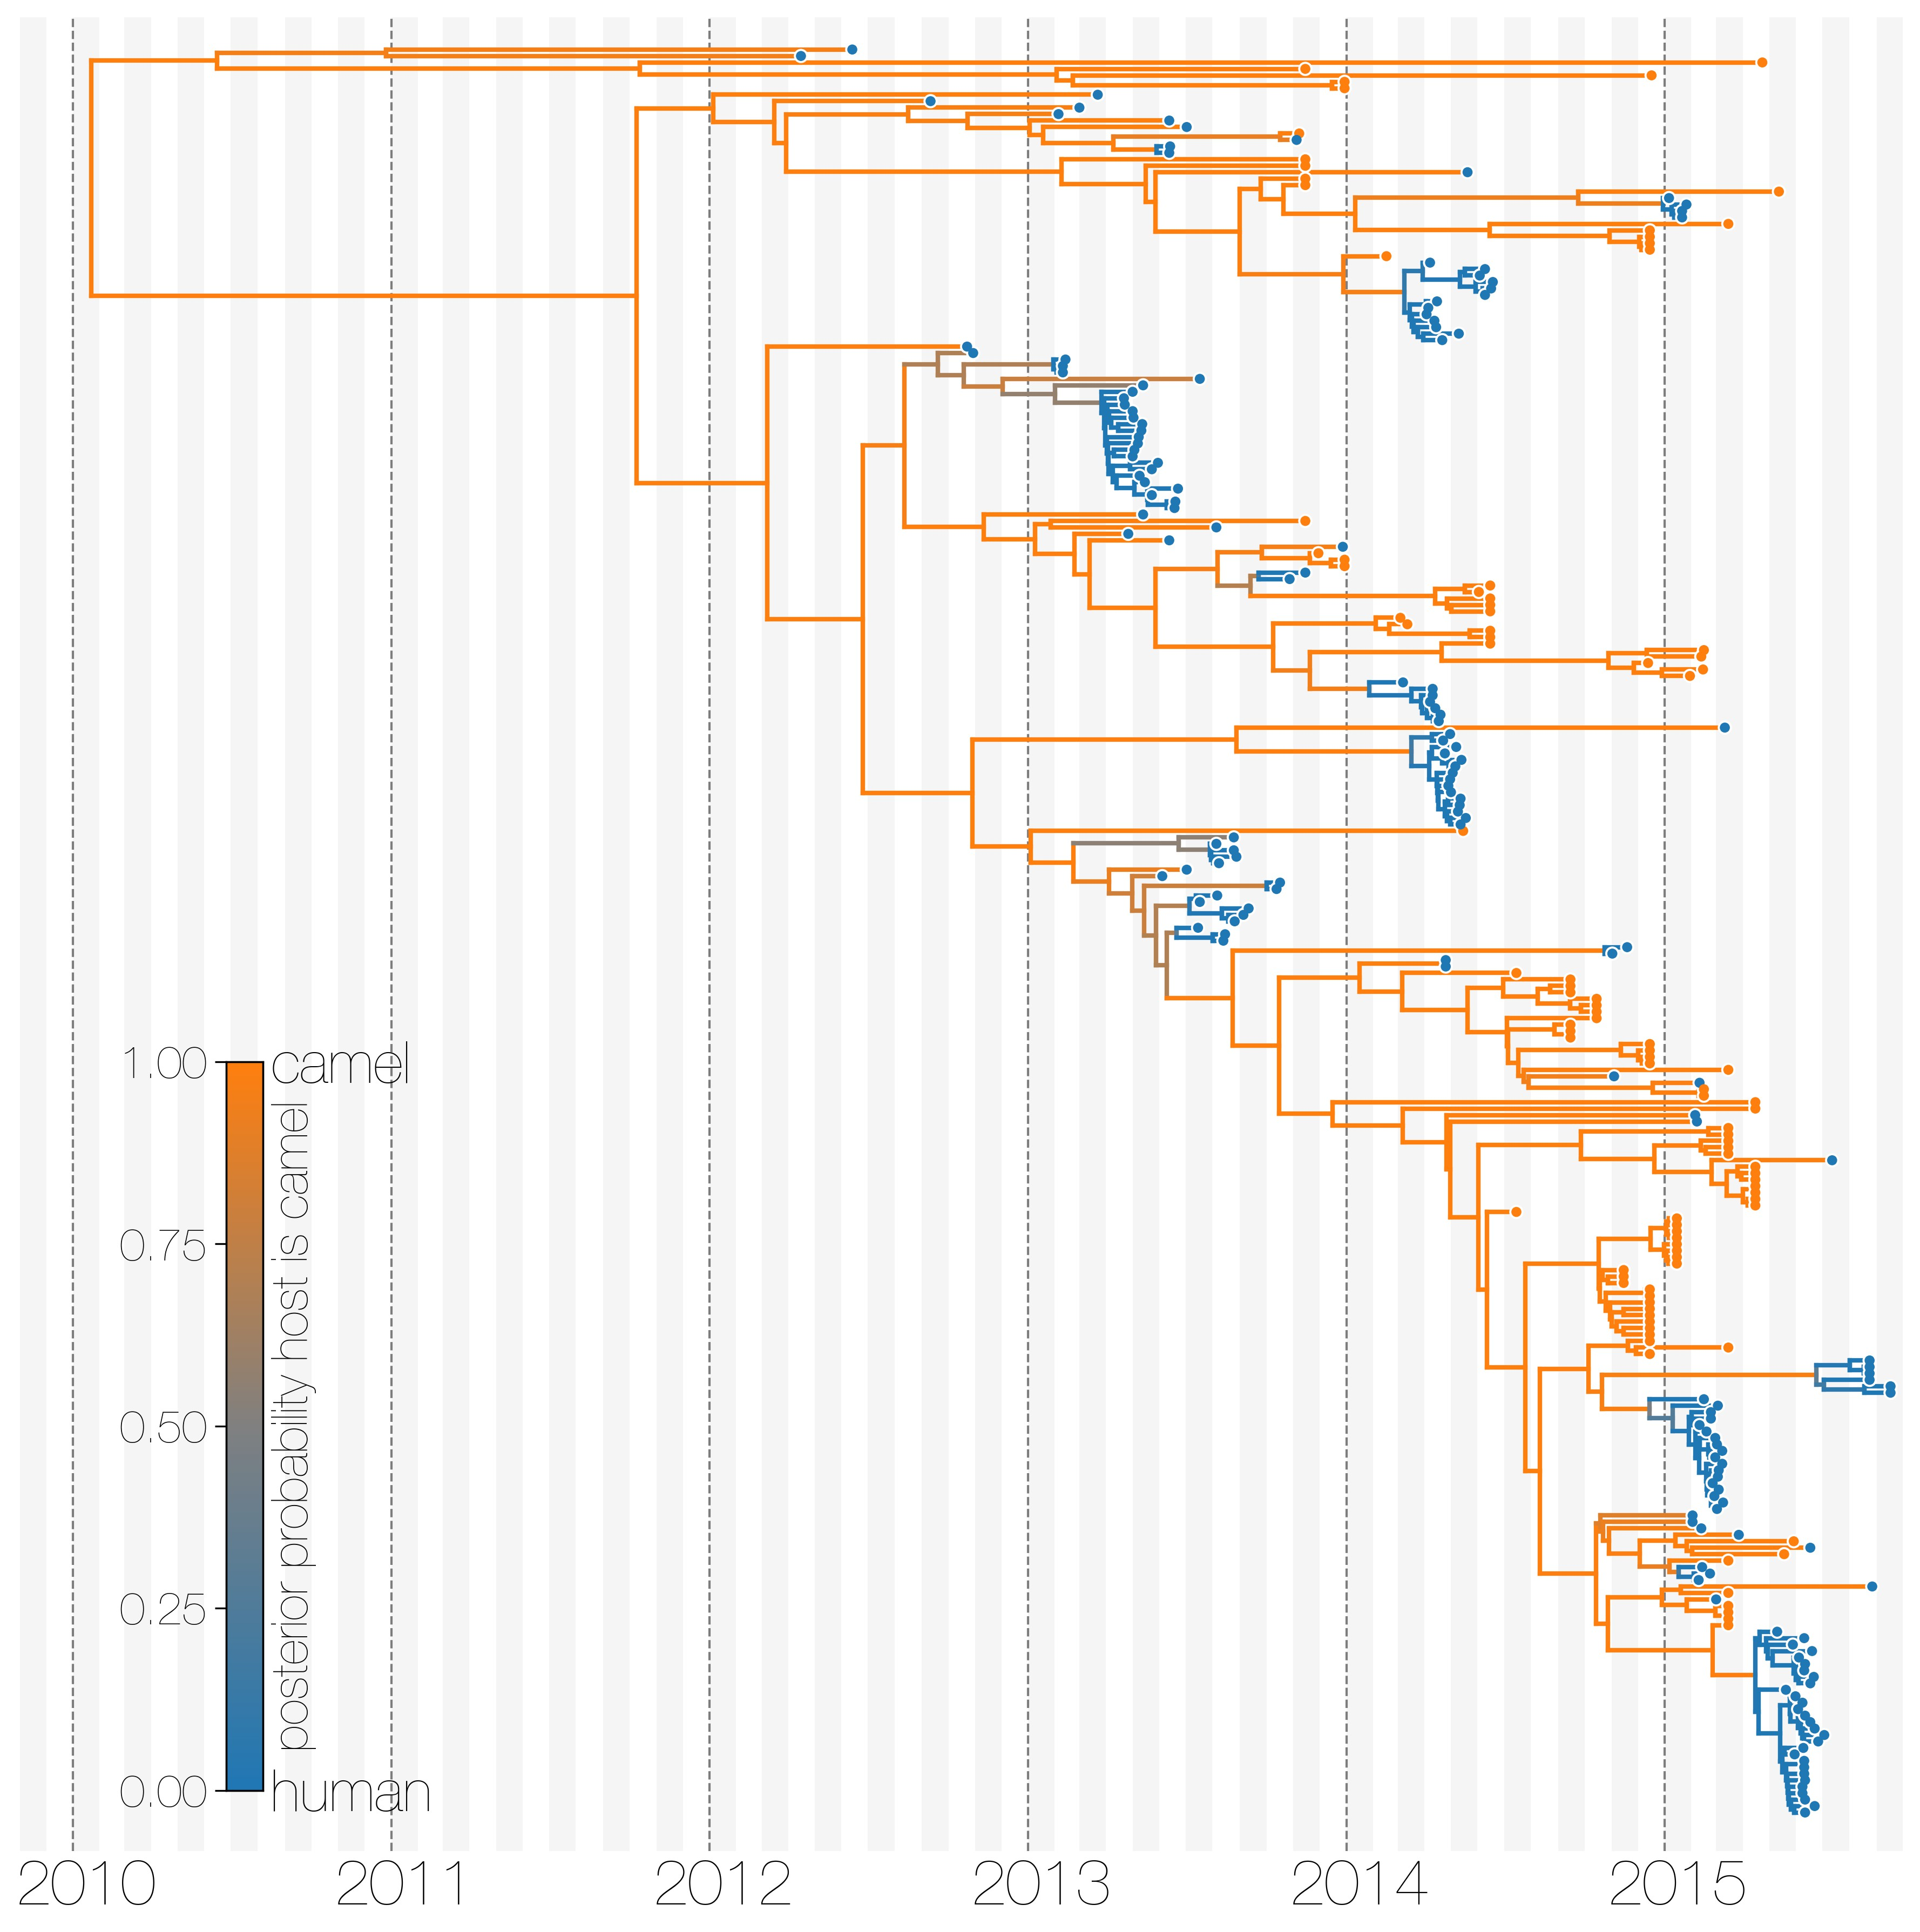
MERS sequences cluster by host of isolation
Dudas et al., 2018, eLife

Slide 4
Phylogenetic trees are formed by population processes and contain information about them

Slide 5
Models to account for population structure:
DTA: Assumes structure to be a neutral trait evolving “on top” of a phylogenetic tree (Lemey 2009).
Structured Coalescent: Models how lineage coalesce within and migrate between discrete locations (Takahata 1988, Hudson 1990).
Multi-type Birth-death models: model lineage-specific birth, death and sampling rates based on discrete types (Stadler 2013).

Slide 6
Tree was generated by a different process (e.g. a coalescent process).
Slide from Timothy Vaughan

Slide 7
Root of the tree is in some location (here red)
Slide from Timothy Vaughan

Slide 8
Then models the migration process on top of this tree from the root to the tips
Slide from Timothy Vaughan

Slide 9
Sampling locations are considered Data.
Slide from Timothy Vaughan

Slide 10
DTA models the migration the same way the substitution process is modelled
Assumes neutrality, meaning that a trait (e.g. geography) does not impact the branching pattern.
Generally fast.
Sampling numbers are assumes to be representative of migration rates. Locations with more samples are likely inferred to be source populations (DeMaio 2015, PLoS Genetics)

Slide 11
Parameters can be informed from outside data using a GLM approach

Slide 12
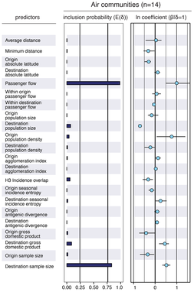
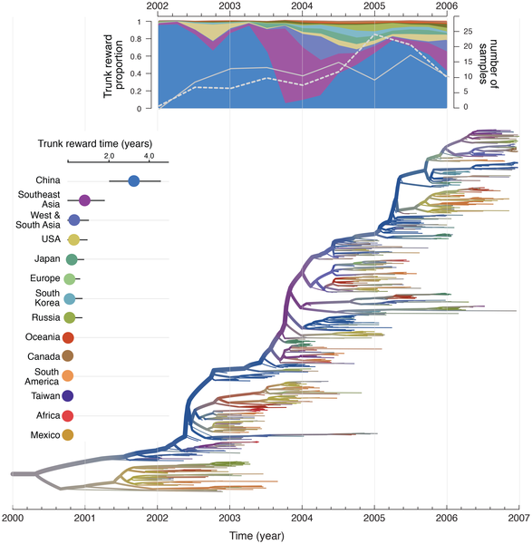
Migration rates in the DTA model can be informed by transportation Data
Lemey et al., 2014, PLoS Path.

Slide 13
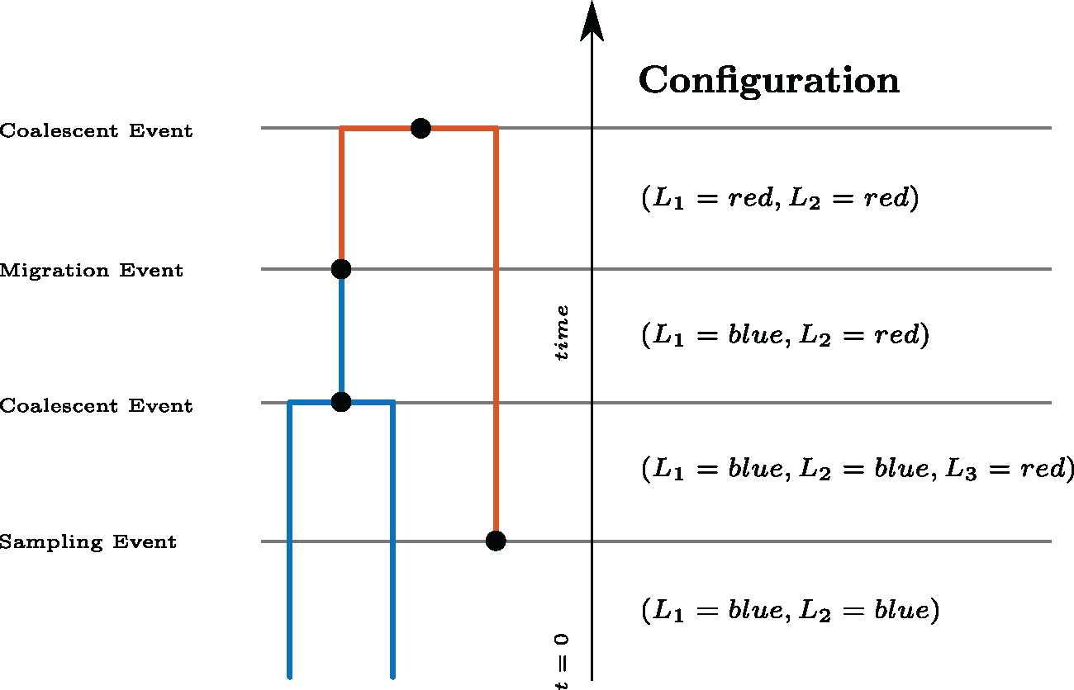
The structured coalescent model how lineage coalesce within and migrate between demes
Müller et al., 2017, MBE

Slide 14
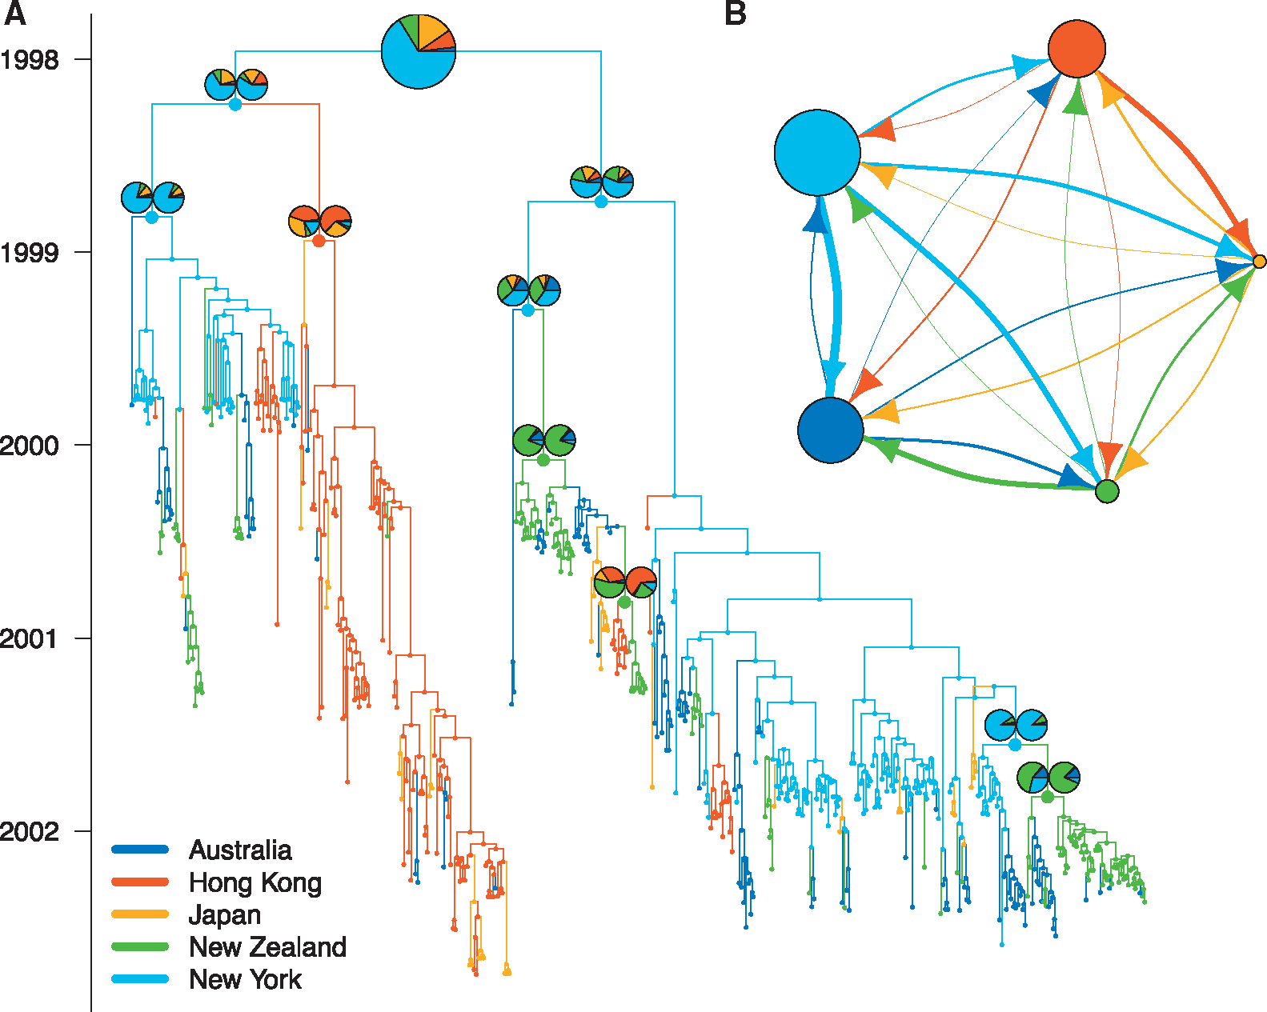
MASCOT approximates the structured coalescent to improve efficiency
Müller et al., 2018, Bioinf.

Slide 15
Time dependent predictors can be linked to migration rates and effective population sizes
Müller et al., 2019, Virus Evol.

Slide 16
Multi-type birth-death process
N types, i = 1,…,N
N birth rates λ_{i}
N death rates μ_{i}
N sampling rates ψ_{i}
Migration rates m_{i,j} ∀ i ≠ j
Kühnert et al. MBE, 2016

Slide 17
Variations
Typed or untyped trees, i.e. trees including the migration history or not (BDMM)
Fixed types at the tips (BDMM) or estimated (MSBD)
Extended multi-type birth-death model with birth rate between demes λ_{i,j} ∀ i ≠ j (BDMM, XML only)

Slide 18
Pros / Cons
Pro: parameter estimates map to biologically meaningful quantities (R₀, length of infectious period, etc)
Con: computational cost (BDMM) or approximations (MSBD)
Con: sensitive to unmodelled sampling discrepancies

Slide 19
Example: tuberculosis
Pečerska et al., in preparation

Slide 20
QUESTIONS?

Slide 21
Some reading material
Paper on DTA: https://doi.org/10.1371/journal.pcbi.1000520
How do different structured coalescent methods compare: https://academic.oup.com/mbe/article-abstract/34/11/2970/3896419
Birth-death models with migration: https://doi.org/10.1093/molbev/msw064
GLM for DTA: https://doi.org/10.1371/journal.ppat.1003932
GLM for MASCOT: https://doi.org/10.1093/ve/vez030

